Slide 1

Portfolio Executive Committee (PEC) Review Meeting
TA INFL
To insert a wordmark:
Add (e.g. via drag and drop) your wordmark file (in RGB) to this slide (in alignment with our brand governance and architecture guidelines)
Change the size of the wordmark according to the height reference (magenta placeholder)
Select the “guides” in the navigation bar and move the wordmark to the right and top line (orange)
  Ying Chen, Bo Wang, Yayun Zhu, Lindsay Xu, Yuting Li | Apr. 23rd, 2026 | 20 min

Slide 2
Part II: Pipeline Update

Slide 3
TA INFL Portfolio Summary - Pipeline Project
Launched
Ongoing/under planning
Under evaluation
Next wave
Nerandomilast
IPF
PPF
SSc
Myositis
Anti-CTGF
IPF/PPF
DcR3-Fc
IBD
Verducatib
BE
COPD
Autotaxin inh.
IPF/PPF
STING inh. BI 3009947
SSC; IFN
PAPP-A inh.
fCD
Anti-TREM1
IBD (CD and UC)
cGAS inh.
SLE；SSc
IFN
Spesolimab
GPP
PG
QPCTL inh.
IPF/PPFr
15-PGDH inh.
IBD
Anti-IL11
IPF/PPF
Stop/Park
CS - FiH
FiH - PoC
Post PoC
Sustain
Termination of STING inh. BI 3009947 in IFN and SSc
The current front-runner compound program was terminated as the PK/PD data from SRD failed to meet the required target engagement, and unable to meet efficacy criteria.
A backup compound is under planning.
Notes:
mann

Slide 4
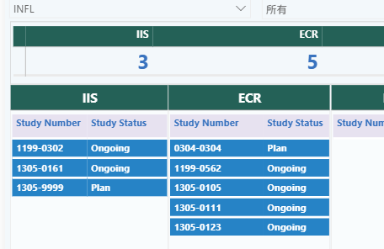
TA INFL Portfolio Summary - PMS Studies
All planned and ongoing studies remain on track.
1199- Ofev
1305- Nerandomilast

Slide 5
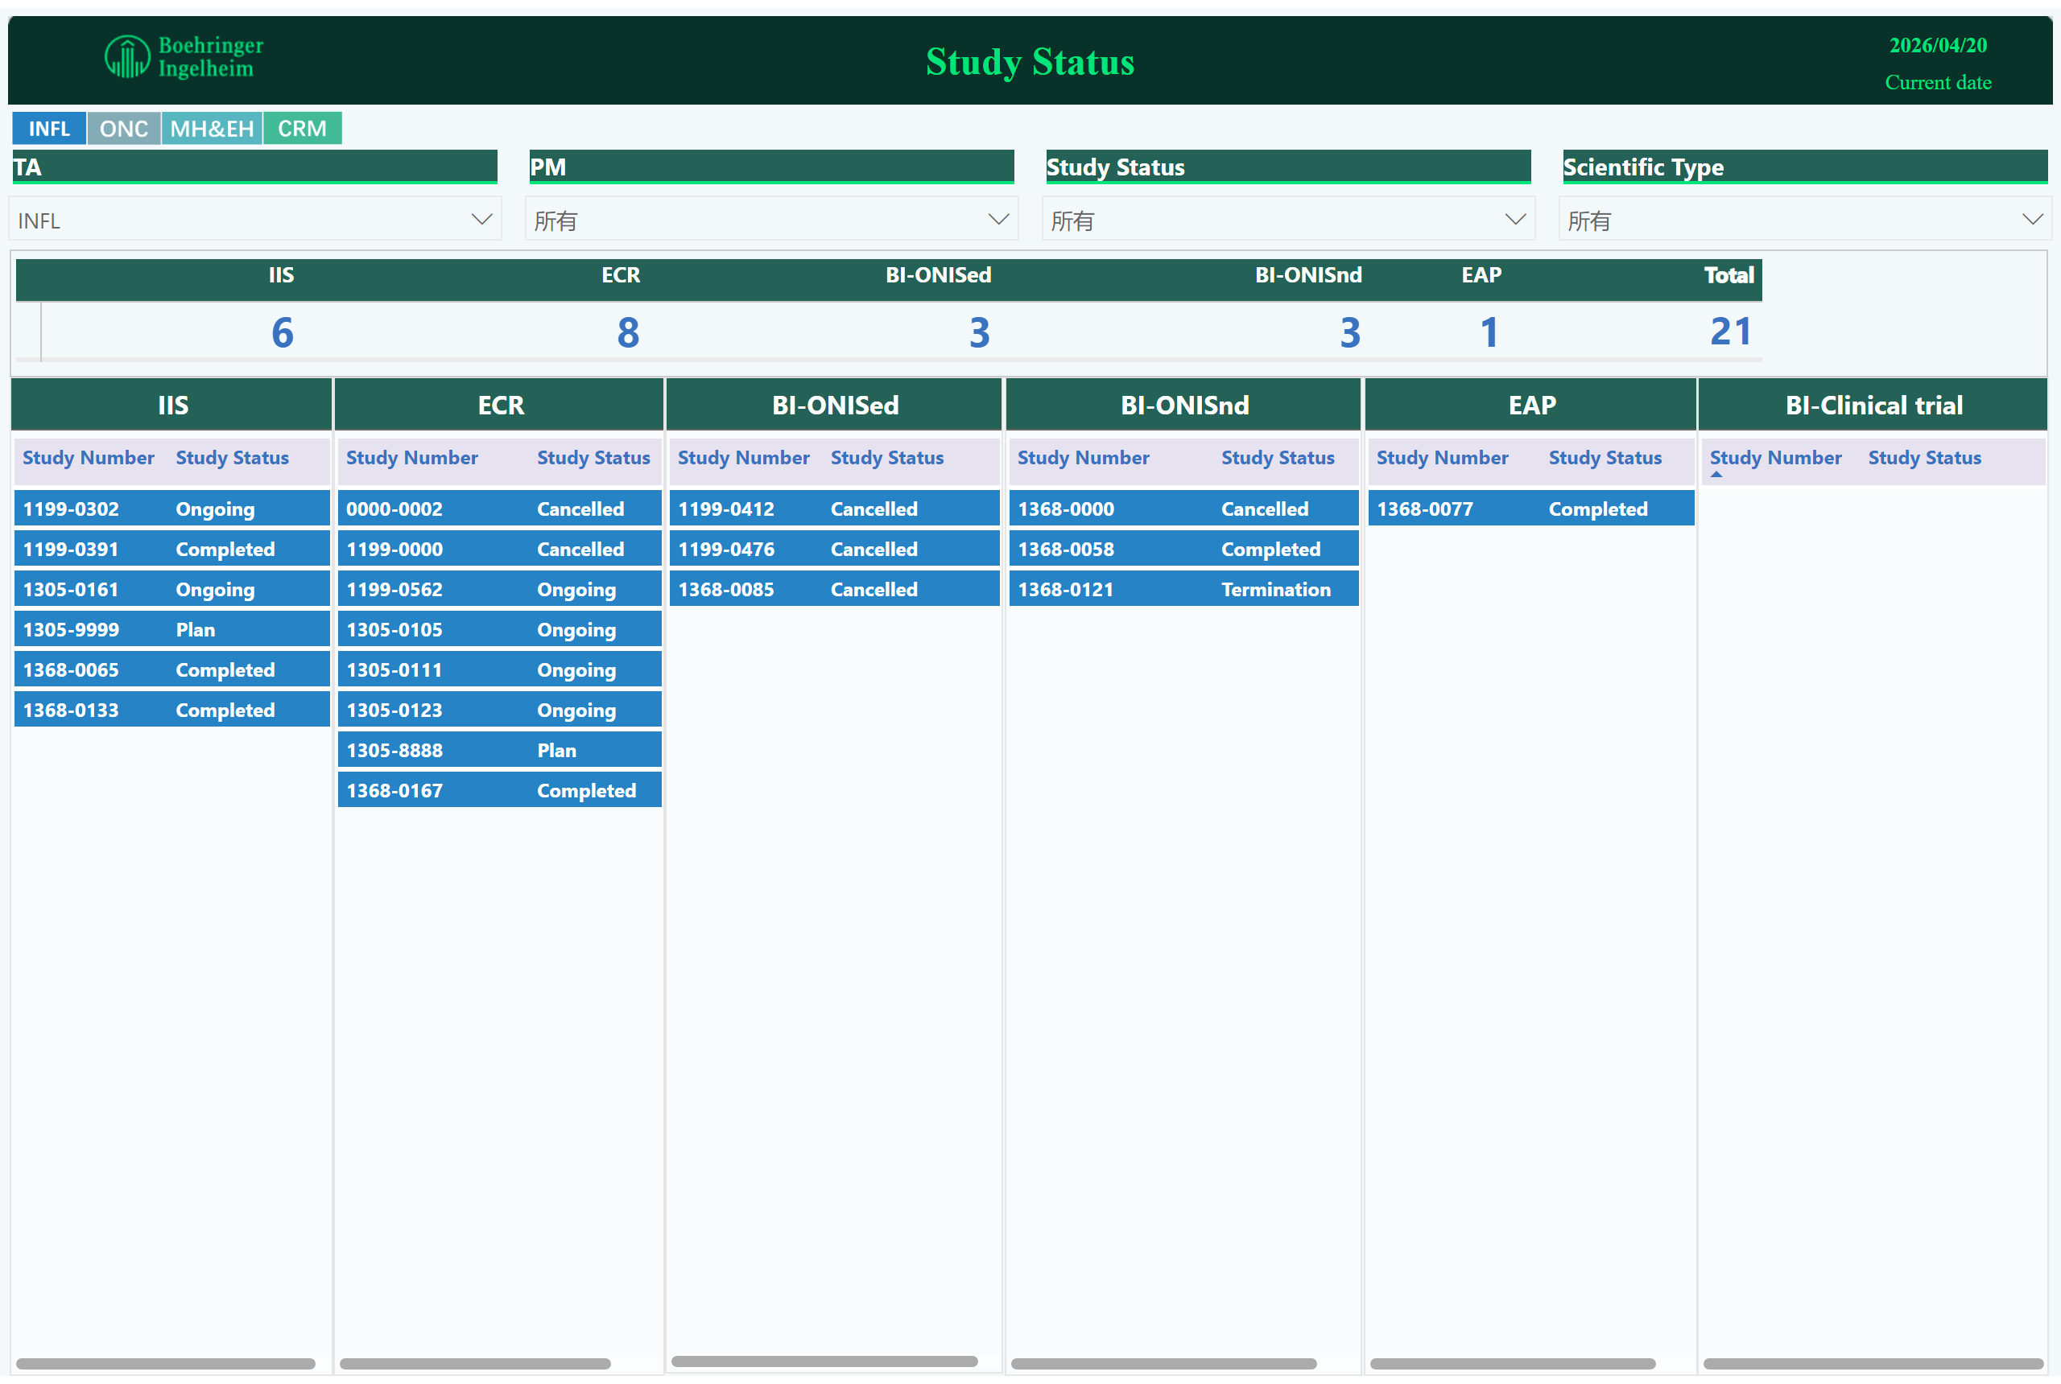
Study Status
TA INFL Portfolio Summary - PMS Studies
1199- Ofev
1305- Nerandomilast
Notes:
ECR
No alt text provided
pivotTable
No alt text provided
image
No alt text provided
textbox
No alt text provided
textbox
No alt text provided
card
No alt text provided
IIS
No alt text provided
slicer
No alt text provided
slicer
No alt text provided
slicer
No alt text provided
slicer
No alt text provided
BI-ONISed
No alt text provided
BI-ONISnd
No alt text provided
EAP
No alt text provided
BI-Clinical trial
No alt text provided
image
No alt text provided

Slide 6
Mature Product/PMS Overview – INFL(Neradomilast)
Product/Study | Indication | Study type (Study no.: FPI-LPO, CTR) | Current Status | Next Mile-stone | Key Updates
Nerandomilast PROFINA (Xiehe Hospital, Prof. XU Zuojun) | PPF | ECR (1305-0105: Oct2025-Jul2028, Dec2028) | FPI (23Sep 2025) | LPI (Jul 2026) | PFI: 23Sep 2025 Enrollment: 5 /600(actual / plan); site: 1/ 30 (initiated/ plan) The new CRO was on board, and the study timeline is under assessment.
Nerandomilast ILD EPI study in China (Zhongguancun Big Data, Prof. ZHOU Maigen) | ILD | ECR (1305-0111: May 2025- Aug 2025, Sep 2026) | Data analysis of part 1&2 (30Sep 2025) | Data analysis of part 3 (Jun 2026) | The Part3 is ongoing.
Nerandomilast Non-interventional study based on existing data: claims data of Beijing (Binhai ,Prof. YIN Peng) | IPF | ECR (Jun 2026- Jan 2027, Sep 2027) | PEC approval (Nov 2025) | Global approval (Mar 2026) | PEC endorsed on 17Nov 2025. Hybrid review was completed in 25Feb 2026, and the result is approved with comments. All reviews approved in Lectrona and waiting for GMA to complete the MM of global release in Lectrona.
Nerandomilast Exploring patients’ experiences with nerandomilast: a longitudinal qualitative research among IPF patients (Peking University Third Hospital, Prof. CHU Hongling) | IPF | ECR(TBD ) | TBD | TBD | Offline preparation and discussion on proposal before CEC Adhoc CEC 0413
Epidemiology and Disease Burden of Systemic Sclerosis (SSc) ​in Beijing: A Study Based on the Beijing Claims Database （Peking University Third Hospital，Prof. ZHUO Lin） | SSc | ECR(TBD ) | TBD | TBD | Offline preparation and discussion on proposal before CEC Adhoc CEC 0413
Nerandomilast (Serum Exosome Combined with Radiomics to Predict Early Progressive Pulmonary Fibrosis) （The first affiliated hospital of Guangzhou medical university，Prof. HAN Qian） | PPF | ECR (1305-0123) (Dec2025-Dec2027, Jun2028) | Amendment EC approval | LPI (Dec 2026) | FPI completed on 20 Oct 2025 Enrollment progress: 178(+24)/325(actual/plan), till 16 Mar 2026;
Multimodal for detection of early IPF (Shanghai Chest Hospital, Prof. LI Feng ) | IPF | IIS (1305-0161) (Jul2018-July2026,July2027) | Protocol approval (Apr 2026) | Contract (Nov 2026) | CEC approval on 1 Sep 2025 Global proposal approved on 3 Nov 2025 Proposal released on 24 Nov2025 Protocol approval on 12 Feb 2026 Contract awaiting the investigator's first-round feedback.
Nerandomilast Biomarker Changes in High-Risk IIM-ILD Patients Treated with Nera plus IS (Renji hospital, Prof. YE Shuang) | IIM-ILD | IIS (TBD) | Proposal submit (Feb2026) | Proposal release (May2026) | PEC approval on 20260209 Proposal submit on 0317 and was locally approved on 0318. Global proposal approve and release process. AMP applied in Mar by email from MA

Slide 7
Mature Product/PMS Overview – INFL(OFEV)
Product/Study | Indication | Study type (Study no.: FPI-LPO, CTR) | Current Status | Next Mile-stone | Key Updates
Ofev (China IPF Registry Study (PORTRAY) (China-Japan friendship hospital, Prof.DAI Huaping) | IPF | IIS (1199-0302) (Jul2018-July2026,July2027) | Follow up | LPO (Jul 2026) | Follow-up visit report will be sent to BI at the early of Apr2026; CDC link：under negotiation between investigator and sponsor Publication for baseline data : Under revision as Prof. Dai‘s comments
Study on the Status Quo of Diagnosis and Treatment of IPF and Quality of Life in China Implementation Protocol (IPF SURVEY) (Peking University Third Hospital, Prof. CHU Hongling) | IPF | ECR (1199-0562; Sep2023-Oct2026) | Phase1 report (May2025) | Ph2 report (May2026) | Phase II enrollment completed on 0324. Total 251 visits(plan 245). Data analysis.

Slide 8
Follow-up action
Product | Indication | Study no. | China Dev. Strat. | actions
Afatinib 40mg | SqCC | IIS (1200-0279) | China alone | Publication plan (ongoing) Budget summary （site template）with PI signature (done on 23Jan 2025)

Slide 9
Mature Product Overview – INFL
Product/Study | Indication | Study type (Study no.: FPI-LPO, CTR) | Current Status | Next Mile-stone | Key Updates
Nerandomilast PROFINA Xiehe Hospital | PPF | ECR (1305-0105: Oct2025-Jul2028, Dec2028) | FPI (23Sep 2025) | LPI (Jul 2026) | PFI: 23Sep 2025 Enrollment: 5 /600(actual / plan); site: 1/ 30 (initiated/ plan) The new CRO was on board, and the study timeline is under assessment.
Nerandomilast ILD EPI study in China National CDC | ILD | ECR (1305-0111: May 2025- Aug 2025, Sep 2026) | Data analysis of part 1&2 (30Sep 2025) | Data analysis of part 3 (Jun 2026) | The Part3 is ongoing.
Nerandomilast Non-interventional study based on existing data: claims data of Beijing National CDC | IPF | ECR (Jun 2026- Jan 2027, Sep 2027) | PEC approval (Nov 2025) | Global approval (Mar 2026) | PEC endorsed on 17Nov 2025. Hybrid review was completed in 25Feb 2026, and the result is approved with comments. All reviews approved in Lectrona and waiting for GMA to complete the MM of global release in Lectrona.
Study on the Status Quo of Diagnosis and Treatment of IPF and Quality of Life in China Implementation Protocol (IPF SURVEY) (Peking University Third Hospital, Prof. Chu) | IPF | ECR (1199-0562; Sep2023-Oct2026) | Phase1 report (May2025) | Ph2 report (May2026) | Phase II enrollment completed on 0324. Total 251 visits(plan 245). Data analysis.
 |  | ECR(Nera定性调查研究) |  |  | Offline preparation and discussion on proposal before CEC Adhoc CEC 0413
 |  | EPI study of SSc |  |  | Offline preparation and discussion on proposal before CEC Adhoc CEC 0413
Nerandomilast (Serum Exosome Combined with Radiomics to Predict Early Progressive Pulmonary Fibrosis) （The first affiliated hospital of Guangzhou medical university，Prof. Han） | PPF | ECR (1305-0123) (Dec2025-Dec2027, Jun2028) | Amendment EC approval | LPI (Dec 2026) | FPI completed on 20 Oct 2025 Enrollment progress: 178(+24)/325(actual/plan), till 16 Mar 2026;

Slide 10
Mature Product Overview – INFL
Product/Study | Indication | Study type (Study no.: FPI-LPO, CTR) | Current Status | Next Mile-stone | Key Updates
Ofev (China IPF Registry Study (PORTRAY) (China-Japan friendship hospital, Prof.Dai) | IPF | IIS (1199-0302) (Jul2018-July2026,July2027) | Follow up | LPO (Jul 2026) | Follow-up visit report will be sent to BI at the early of Apr2026; CDC link：under negotiation between investigator and sponsor Publication for baseline data : Under revision as Prof. Dai‘s comments
multimodal for detection of early IPF (Shanghai Chest Hospital, Prof. Li ) | IPF | IIS (1305-0161) (Jul2018-July2026,July2027) | Protocol approval (Apr 2026) | Contract (Nov 2026) | CEC approval on 1 Sep 2025 Global proposal approved on 3 Nov 2025 Proposal released on 24 Nov2025 Protocol approval on 12 Feb 2026 Contract awaiting the investigator's first-round feedback.
Nerandomilast Biomarker Changes in High-Risk IIM-ILD Patients Treated with Nera plus IS (Renji hospital, Prof. Ye) | IIM-ILD | IIS () | Proposal submit (Feb2026) | Proposal release (May2026) | PEC approval on 20260209 Proposal submit on 0317 and was locally approved on 0318. Global proposal approve and release process. AMP applied in Mar by email from MA

Slide 11
Update Nerandomilast

Slide 12
Overview: China Development Plan - Nerandomilast
Projects | Study ID | Current status | NDA approval (best case)
IPF | 1305-0024 Phase 1 CN PK study | Completed | /
 | 1305-0014 FIBRONEER-IPF, ph3, IPF | NDA approved | US: Oct 7, 2025 CN: Oct 21, 2025
 | 1305-0031 FIBRONEER-ON, ph3 OLE, IPF + PPF | Follow-up ongoing | /
PPF | 1305-0023 FIBRONEER-ILD, ph3, PPF | NDA approved | US: Dec 19, 2025 CN: Dec 9, 2025
 | 1305-0046 FIBRONEER-SARD, ph3b, SARD-ILD | Recruitment ongoing | /
 | 1305-0152 FIBRONEER-ACT, ph3b, non-IPF fibrosing ILD | CTA under preparation | /
chILD | 1305-0022 Ph3, chILD | CTA under review | US: Mar 2030 CN: Aug 2030
SSc | 1305-0052 Ph3, SSc | CTA submitted | US: Feb 2031 CN: Jul 2031
IIM | 1305-0146 Ph3, IIM | Pre-IND mtg request submitted | US: Mar 2031 CN: Aug 2031

Slide 13
CCDS/China LPI update
Dispatch date | 18 February 2026
CCDS/CC IFU version | 0306-04
Urgency Level | URGENCY LEVEL 2
Rationale for the update | For the update in Dosage and in Interactions: Integration of results from drug-drug interaction studies 1305-0119 and 1305-0113 for concomitant use with strong or moderate CYP3A inducers. Additional edits to enhance accuracy and clarity*
Submission plan | US: sub in Mar 2026 and implemented in Sept 2026 EU: sub during MA review and implemented with MA approval CN: submission planned by end of Mar and approval around Aug 2026
The revised LPI proposal was submitted to CDE on March 31st, with acceptance notice on April 17th. Approval is anticipated by August 12th.
* Add the subgroup result for primary endpoint in FIBRONEER-IPF.
* Change the description of exposure duration to observation time in [clinical trial] section.
* Clarification on non-clinical and PK study result.

Slide 14


Nerandomilast (PDE4b inhibitor): Idiopathic Pulmonary Fibrosis(IPF) and Progressive Pulmonary Fibrosis (PPF) Development Plan
2022 |  |  |  | 2023 |  |  |  | 2024 |  |  |  | 2025 |  |  |  | 2026 |  |  |  | 2027
Q1 | Q2 | Q3 | Q4 | Q1 | Q2 | Q3 | Q4 | Q1 | Q2 | Q3 | Q4 | Q1 | Q2 | Q3 | Q4 | Q1 | Q2 | Q3 | Q4 | Q1
We are here
Ph3-1305.14
Sep 26
5Jun 2023
Aug 2024
IPF N=1077
US NDA Sub
7 Feb 2025
US NDA appr.
7 Oct 2025
FSS
LSS
Last patient Primary
endpoint
US NDA appr.
19 Dec 2025
Ph3-1305.23
Nov 8
1Nov2023
Dec 2024
US NDA Sub
5 May 2025
PF-ILD N=1078
Ph3 OLE-
1305.31
Last patient Primary
endpoint
26Sep 2024
Jan 2027
Ph3 OLE
FSS
LSC
China
Jul2022
Dec2022
19 Feb 2025
12 Sep 2025
Oct 2025
Ph3-
1305.14
CTA Review + EC + HGRAC + 1st SIV (5.5 M)
CN ML N=97
TW: N=22
NDA review for IPF
CTA Sub
NDA Sub
CDE Panel Meeting
NDA Appr.
12 Nov 2025
Apr 30 2025
Dec 9 2025
Ph3-
1305.23
CTA Review + EC + HGRAC + 1st SIV (5.5 M)
Allocated China ML N=155, TW: N=28
NDA review for PPF
CTA Sub
1st SIV
26Sep 2024
NDA Sub
CDE Panel Meeting
NDA App
Jan 2027
Sep 2023
CTA Review + EC + HGRAC + 1st SIV
Ph3 OLE-
1305.31
FSS
LSC
LSS: Last subject screening
LSLV: Last subject last visit
DBL: database lock
HAI: Healthy authority interaction
INN: International Nonproprietary Names
ChP: Chinese Pharmacopoeia Commission
BE: Bioequivalence
OLE: Open label extension
China PK 1305.24
13 Jan 2023
17Mar2023
14Jul2023
Jan 2024
CTP 7.0 dispatched in Mar and considered as non-substantial change, will be reported by DSUR in May 2026
IMPD 4.0 dispatched on Apr 2, will be implemented in DSUR.
CTA Review + EC + HGRAC (6M)
CN PK
CTA Sub
SIV
LPO
DBL
CTR

Slide 15

Ongoing: Nerandomilast (PDE4b inhibitor): Systemic autoimmune rheumatic diseases-associated Interstitial Lung Diseases (SARD-ILD) Development Plan
2024 |  |  |  | 2025 |  |  |  | 2026 |  |  |  | 2027
Q1 | Q2 | Q3 | Q4 | Q1 | Q2 | Q3 | Q4 | Q1 | Q2 | Q3 | Q4 | Q1 | Q2 | Q3 | Q4
We are here
21 Aug 2024
22 Oct 2024
13 Sep 2025
15 Dec 2026
30 Jul 2027
30 Dec 2027
Ph3b-1305.46
Recruitment window = 16 M
152 sites, N = 400
CTA Sub
CTA appr
CTR
FSS
LSS
LPO
13 Sep 2025
15 Dec 2026
30 Jul 2027
21 Aug 2024
11 Nov 2024
CTA Review + EC + HGRAC + 1st SIV (6 M)
Recruitment window ~16 M
17 sites, N=27
Ph3b-1305.46
CTA Sub
CTA appr
FSS
LSS
LPO
Recruitment is ongoing.
TDO: trial design outline
FSS: first subject screen
LSS: last subject screen
LPO: last patient out

Slide 16
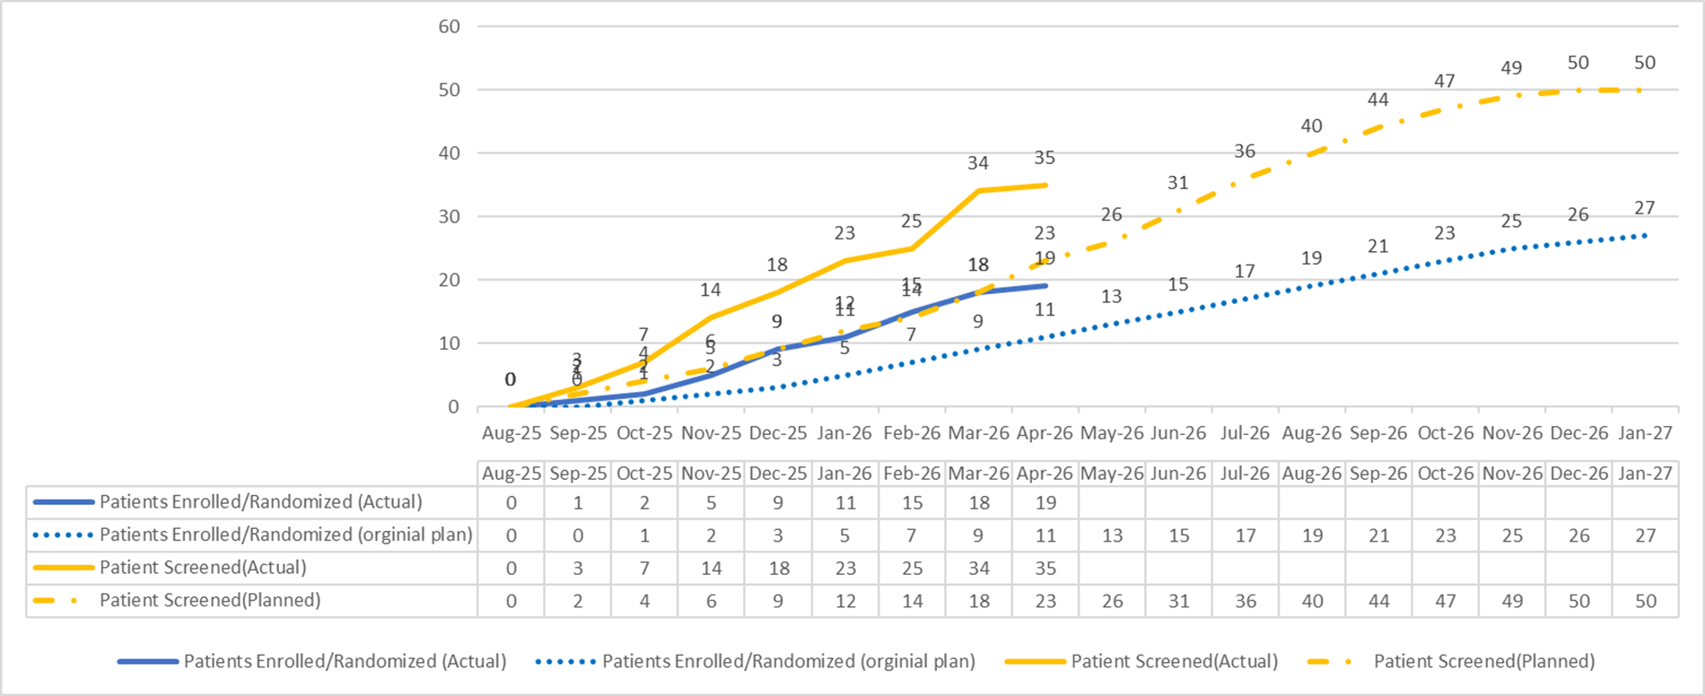
China Level Report: recruitment
Trial Number:
1305-0046
BI Substance:
BI 1015550
Mode of Action:
PDE4b inhibitor
Therapeutic Area:
INFL
Target population:
27 (China)
400 (Global)
Phase:
IIIb
Cut-off date: 2026.04.15
Total Screened = 35 (China. +8) / 308 (Global)
Total Randomized = 19 (China, +4) / 161 (Global)
Total Screen failure = 14 (China) / 68 (Global)

Slide 17
Ongoing: Nerandomilast (PDE4b inhibitor): non-IPF fibrosing ILD Development Plan
2025 |  |  |  | 2026 |  |  |  | 2027 |  |  |  | 2028 |  |  |  | 2029
Q1 | Q2 | Q3 | Q4 | Q1 | Q2 | Q3 | Q4 | Q1 | Q2 | Q3 | Q4 | Q1 | Q2 | Q3 | Q4 | H1 | H2
We are here
15 May 2026
31Aug 2026
Dec 2028
Ph3b-1305.152
180 sites, N = 466
CTA Sub
FSS
LPO
22 May
2026
TBU
Dec 2028
Ph3b-1305.152
18 sites, N=49 (pre-liminary allocation)
CTA Sub
FSS
LPO
CTA preparation is ongoing.
SQVs in 18 sites are ongoing.
TDO: trial design outline
FSS: first subject screen
LSS: last subject screen
LPO: last patient out

Slide 18
Onogoing: Nerandomilast (PDE4b inhibitor): Pediatric Fibrosing Interstitial Lung Diseases (chILD) Development Plan
2025 |  |  |  | 2026 |  |  |  | 2027 |  |  |  | 2028 |  |  |  | 2029 |  |  |  | 2030 |  | 2031 |  | 2032
Q1 | Q2 | Q3 | Q4 | Q1 | Q2 | Q3 | Q4 | Q1 | Q2 | Q3 | Q4 | Q1 | Q2 | Q3 | Q4 | Q1 | Q2 | Q3 | Q4 | H1 | H2 | H1 | H2 | H1 | H2
We are here
15 Jan 2026
Feb
2026
15 Jun 2026
23 Jun 2028
1 Jun 2029
14 Apr 2031
Ph3-1305.22 (include OLE)
CTA sub.
CTA appr.
N = 30
FSS
LSS
Main DBL
OLE
LPO
22 Sep 2029
20 Mar 2030
NDA sub.
NDA appr.
Ph3-1305.22 (include OLE)
13 Mar 2026
10 Aug
2026
12 Sep 2025
1Jun 2026
3 sites, N=2
Pre-IND sub.
CTA sub.
CTA appr.
1st SIV
22 Oct 2029
20 Aug 2030
NDA sub.
NDA appr. (best case)
The China CTA was submitted on Mar 13, with approval expected by mid-June.
The China IM is scheduled for Jul 3 in Shanghai.

Slide 19
Ongoing: Nerandomilast (PDE4b inhibitor): Systemic Sclerosis (SSc) Development Plan
2025 |  |  |  | 2026 |  |  |  | 2027 |  |  |  | 2028 |  |  |  | 2029 |  |  |  | 2030 |  |  |  | 2031
Q1 | Q2 | Q3 | Q4 | Q1 | Q2 | Q3 | Q4 | Q1 | Q2 | Q3 | Q4 | Q1 | Q2 | Q3 | Q4 | Q1 | Q2 | Q3 | Q4 | Q1 | Q2 | Q3 | Q4 | Q1 | Q2 | Q3 | Q4
We are here
31Jan 2027
15Apr 2028
Ph2b-1305.40
CONQUEST Trial, SSc-ILD, ph2b
IA
Key results
15 Aug 2025
18 Nov 2025
12 Mar 2026
9 Jun 2026
12Apr
2030
Aug
2030
Feb
2031
Ph3-1305.52
SSc Ph3 (N=448)
RoFD
CTA sub.
DBL
NDA sub.
NDA appr.
HAI
FSS
China
21 Aug 2025
13 Apr
2026
12 Oct 2026
Sep
2030
Jul
2031
Ph3-
1305.52
SSc Ph3 (N=45)
HAI
CTA sub.
FSS
NDA sub.
NDA appr.
US IND open was achieved on Apr 10. Non-hold comments from FDA are anticipated in May, which may trigger CTP amendment. ODD was granted by FDA on Apr 9.
The China CTA was submitted on Apr 13, with acceptance notice received on Apr 17. Approval is expected by Jul 15.
Leading site GCP submission is completed on Apr 20 and currently under review.

Slide 20
Ongoing: Nerandomilast (PDE4b inhibitor): Idiopathic Inflammatory Myopathies (IIM) Development Plan
2025 |  |  |  | 2026 |  |  |  | 2027 |  |  |  | 2028 |  |  |  | 2029 |  |  |  | 2030 |  |  |  | 2031
Q1 | Q2 | Q3 | Q4 | Q1 | Q2 | Q3 | Q4 | Q1 | Q2 | Q3 | Q4 | Q1 | Q2 | Q3 | Q4 | Q1 | Q2 | Q3 | Q4 | Q1 | Q2 | Q3 | Q4 | Q1 | Q2 | Q3 | Q4
We are here
Ph3-1305.146
2 Jul 2025
9 Jan
2026
27 Mar 2026
17 Jun 2026
Sep 2026
Mar/Apr 2030
Sep 2030
Mar 2031
IIM Ph3 (n~270)
Release of SoD
HAI sub.
RoFD
CTA sub.
FSS
DBL
NDA sub.
NDA Appr.
China
Mid Jun
2026 (TBC)
15 Jan
Dec 2026
Oct 2030
Aug 2031
Ph3-
1305.146
IIM ph3
HAI sub.
CTA sub.
NDA Appr.
FSS
NDA sub.
RoFD was released on Mar 27.
Final feedback from the FDA and EMA for HAI has been received, along with initial feedback from the PMDA. Updates for TDO/CTP are in progress, and the CTA is currently being prepared. China HAI is still under review.
SQVs in 21 sites are in progress.

Slide 21
Summary of HAI feedbacks, risks and mitigation plan
Summary of HAI feedbacks | Current status | Key risks | Mitigation plan
FDA (written response): Insufficient evidence and a ph2 dose‑ranging POC study is strongly recommended. A broad IIM indication not supported and development should focus on specific disease subgroups (e.g., DM). Primary endpoint (TIS) validity and clinical meaningfulness must be justified per disease subgroups. EMA (written response): Rationale supports direct ph3 entry in IIM; design and dose selection are acceptable. TIS acceptable as primary endpoint despite remaining validation limitations. Exclusion of IBM/IMNM may affect the indication label. Supportive evidence is limited; MA remains uncertain. PMDA (preliminary feedback): An exploratory ph2 PoC study is recommended prior to ph3, but study initiation and Japan participation are not precluded. CDE (under review): Summaries of the feedback from FDA and EMA have been submitted. | RoFD of IIM ph3 program was released. TDO and CTP update are in progress. Ph3 CTA preparation is ongoing and submission will proceed as planned (Jun). | CTA approval: CDE may challenge the scientific justification for initiating a ph3 study directly. EC approval: EC may request the CDE’s feedback on HAI. If concerns are documented in the written response, site EC may also raise concerns or delay approval. | Closely follow with global team to ensure incorporation of key regulatory feedback from all HAs into the final CTA/EC packages. Collaborate with global team and strengthen the overall evidence package by proactively addressing identified data gaps, including clear justification of endpoints, target population, and supportive evidence strategy.

Slide 22
Summary of HAI feedbacks from FDA/EMA/PMDA
 | FDA-written response | EMA-written response | PMDA-preliminary feedback
Summary of HAI feedback | We do not agree with your proposal for a general indication for IIM, and we strongly recommend that you base your development program on specific, clearly defined diseases (e.g., DM). You will need to justify the content validity of TIS and the clinical meaningfulness of observed differences for each of the different diseases you evaluate. The adequacy of your justification will be a review issue. Given the limitations of the available data from the small subgroup of IIM-ILD subjects from Study 1305-0023, it is highly uncertain how this information could reasonably serve as confirmatory evidence. The relevance of the proposed mouse bleomycin model to inflammatory myopathies is minimal. We reiterate that you currently have very limited clinical information to inform the preliminary efficacy and safety of nerandomilast for IIM and strongly recommend that you conduct a phase 2, dose-ranging, POC study or studies. Whether a single well-controlled trial, together with supportive data (e.g. from a well-designed, well-conducted POC study), will be sufficient will depend on review of the data and strength of the results. The sufficiency of a single study to support approval will depend on factors beyond only achieving small p-value. Such a determination would also depend on a lack of new safety signals in a treatment population that would require further characterization. | There is sufficient rationale to proceed directly to a pivotal Phase III clinical trial in IIM, based on a sufficient non‑clinical package, a supported mechanistic rationale, supportive PD signals observed in IIM‑ILD, and extensive safety experience in related fibrosing ILDs. Overall, the proposed study design seems acceptable. The exclusion of subgroups (IBM, IMNM) will likely have implications on the indication label. Certain limitations seem to remain regarding the validation status and interpretability of TIS. However, its use as the primary endpoint—supported by a responder analysis (TIS-40) and complementary analyses of the individual Core Set Measures—can be considered overall acceptable. Current dose selection is acceptable. The non-clinical efficacy data and data from a subgroup of IIM patients from the ILD trials are considered to provide only limited supportive evidence. Whether a single pivotal trial will provide sufficiently robust and compelling evidence to support MA will be a matter of assessment. | Mar 23, PMDA preliminary feedback: PMDA 's opinion is such that it is desirable to conduct an exploratory study in IIM patients to collect information that would support the selection of an appropriate target population and the determination of primary efficacy endpoints and then design and conduct a confirmatory study based on such findings. But PMDA does not preclude from initiation the study and join from Japan. Apr 1, Meeting outcome (internal interpretation) : PMDA does not object to the initiation of the 1305-0146 study, as there appears to be no significant safety concerns. PMDA considers the primary endpoint to be TIS with a cut off level (e.g. TIS-40, etc.), which has international consensus. There have been changes to the target population (inclusion, exclusion criteria) after providing PMDA’s pre-opinion, they could not be able to conclude their opinion for these changes.
Next step | TDO/CTP update and CTA submission will proceed.

Slide 23
Update Verducatib

Slide 24


Verducatib/BI 1291583 (DPP-1 inhibitor): Bronchiectasis
2022 |  | 2023 |  |  |  | 2024 |  |  |  | 2025 |  |  |  | 2026 |  |  |  | 2027 |  |  |  | 2028 |  |  |  | 2029 |  | 2030
Q3 | Q4 | Q1 | Q2 | Q3 | Q4 | Q1 | Q2 | Q3 | Q4 | Q1 | Q2 | Q3 | Q4 | Q1 | Q2 | Q3 | Q4 | Q1 | Q2 | Q3 | Q4 | Q1 | Q2 | Q3 | Q4 | H1 | H2 | H1 | H2
Phase 2
1397-0012
Jan 2023
Sep 2023
Jun 2024
Dec 2024
Airleaf Ph II 1397-0012
Aug 2022
PoCC
RoFD
PoCP
LSS
Nov 2023
Q4 2024
Phase 2
1397-0013
Clairafly 1397-0013 CF Profiling study
Q3 2023
Q3 2026
Dec 2027
Aug 2028
Phase 2
1397-0017
Clairleaf Phase 2 CFBE + nCFBE roll-over study
Feb 2025
US NDA
US Approval
Phase 3
1397-0014
16 Jun 2025 FSS
20 Sep 2027, DBL1 (adults)
AIRTIVITY 1397-0014 Phase 3
Jan 31, 2028, DBL-2 (adolescents)
CTA
Phase 3
1397-0018
1397-0018 Phase 3 nCFB+/- CFB roll-over study
Sep 2024
Feb 2025
Jul 2025
20 Sep 2027, DBL1 (adults)
Phase 3
1397-0014
CTA Review + EC + HGRAC + 1st SIV (6m) *
AIRTIVITY 1397-0014 Phase 3
Jan 31, 2028, DBL-2 (adolescents)
EoP2 HAI
Req. Subm.
CTA
1st SIV
Phase 3
1397-0018
1397-0018 Phase 3 nCFB+/- CFB roll-over study
1680 adults
1440 NCFBE
240 CFBE
Dec 2027
Best: Dec 2028
Base: June 2029
Phase 1 PK
1397-0027
13 Jul 2026
11 Oct 2026
Apr 2027
CTP v2
1755 (1680 adults + 75 adols)
Protocol develop
CTA Review + EC + HGRAC + 1st SIV (6m) *
China PK
FSS
LSO
Key PK results
CN NDA
China Approval
China Approval
75 adolescents
≥70% NCFBE
≤30%CFBE
CTP v3 – Mid Apr 2026
DBL Timing - Flexibility
we are here

Slide 25
Global Recruitment (by Apr 20th, 2026)
TOP 3 screening
1 China, 323
2 Germany, 267
3 USA, 265
TOP 3 randomization
1 China, 242
2 Germany, 199
3 USA, 150
Cut-off date: 20-Apr-2026
Total Screened = 2243
Patient in Screening= 407
Total Randomized = 1558
Total Screen failure = 335
Screen failure rate = 15%
11 adolescent patients were screened, 2 were randomized
Notes:
Global并未提供3-7月筛选和随机的具体计划，根据现有数据进行推测。

Slide 26
Local Recruitment (by Apr 20th, 2026)
Cut-off date: 20-Apr-2026
Total Screened = 323
Patient in Screening= 15
Total Randomized = 242
Total Screen failure = 68
Screen failure rate = 21%

Slide 27
Status Update: New Indication(s) Evaluation for Verducatib Ongoing
Request conditional approval for RoFD for TWO indications for asset maximization for verducatib.
BUEC Decision in Mar 26.
COPD:
Reactivation of the COPD program and RoFD were granted.
  HAI starting from June, China CTA in Sep 2026.
ANCA-AV:
RoFD not granted, but there are some follow ups to review and then BUEC will decide on the next steps.
Next Steps for China team:
HAI in June, CTA in Sep 2026
Leading PI & Steering committee member proposal by Q2 2026

Slide 28
Update Spesolimab

Slide 29
Overview: China Development Plan - Spesolimab
Projects | Study ID | Current status | Planned start of operational transfer*
GPP | 1368-0025 Effisayil ON, ph2, Open label extention study | Recruitment completed, treatment ongoing | Q1-2026
 | 1368-0120 Effisayil REP, ph3b/4, GPP flare retreatment | Recruitment completed, treatment ongoing | N/A, Completion to Final CTR: Feb 2027
PG | 1368-0140 Capsayil, Ph3, PG | Recruitment ongoing | N/A, Completion to All site closure: Jun 2028
NS | 1368-0104 Ph2/3, NS | Terminated | /
HS | 1368-0098 Ph2b/3, HS | Terminated | /
* Source: Spevigo licensing and transfer to Leo Pharma Playbook for Countries, Date: 30 September 2025
The sponsorship transfer applications (included in protocol amendment) :
1368-0025: 1) as CDE required, will be submitted in parallel with the MAH transfer, which is targeted for 23 April (several days delay and waiting for LEO update this week) , aiming to be approved by 31Jul and sponsorship transfer competed by 30Sep with HGRAC approval. 2) protocol & ICF amendment approved by leading site EC on 4Mar.
1368-0140: CDE approval obtained on 31Mar2026.
MAH: Marketing Authorization Holder

Slide 30
Spesolimab (Anti-IL36R): General Pustular Psoriasis (GPP)
2020 |  | 2021 |  | 2022 |  | 2023 |  | 2023 |  | 2024 |  | 2024 |  | 2025 |  | 2023 |  | 2026 |  | 2024 |  | 2027
Q1 Q2 | Q3 Q4 | Q1 Q2 | Q3 Q4 | Q1 Q2 | Q3 Q4 | Q1 | Q2 | Q3 | Q4 | Q1 | Q2 | Q3 | Q4 | Q1 | Q2 | Q3 | Q4 | Q1 | Q2 | Q3 | Q4 | Q1 Q2 | Q3 Q4
NDA App (US)
for GPP Flare Sep 2022
We are here
Ph3b/4-1368.120
Oct 2023
Jun 2024
Nov 2026
recruitment (N=40)
FSS
LSS
LSC
Ph2 OLE-1368.25
Feb 2023
Jan 2028
N=130
LSS
LSC
NDA App for GPP Flare
CN ML: 13Dec2022
TW: 6Jan2023
Jun 2023
16Oct2023
Jun 2024
Nov 2026
Ph3b/4-1368.120
EC + HGRAC + 1st SIV
China Mainland: N=5 TW: N=2
1st SIV
LSS
LSC
Ph2 OLE-1368.25
Sep 2020
Oct 2022
Dec 2027
N=14
1st SIV
LSS
LSC
1368-0025 OLE study:
Trial on track. Planned start of operational transfer in Q1 2026*
1368-0120 Flare retreatment study:
Trial on track. Completion to final CTR* in Feb 2027
FSS: First subject screening
LSS: Last subject screening
LSC: Last subject complete
LSR: Last subject randomization
CN ML: China mainland
TW: Taiwan
* Source: Spevigo licensing and transfer to Leo Pharma Playbook for Countries, Date: 30 September 2025

Slide 31
Spesolimab (Anti-IL36R): Pyoderma Gangrenosum (PG)
2024 |  |  |  | 2025 |  |  |  | 2026 |  |  |  | 2027 |  |  |  | 2028
Q1 | Q2 | Q3 | Q4 | Q1 | Q2 | Q3 | Q4 | Q1 | Q2 | Q3 | Q4 | Q1 | Q2 | Q3 | Q4 | Q1-Q4
We are here
FSS: 4Feb2025
Apr 2027
Aug 2028
CTA Jul 2024
1st SIV: 14Jan2025
FSS-LSR n=90, recruit. Window: ~26m,
LSR-LSC
Pre-IND
CTA Review + EC + HGRAC
FSS-LSR n=14, recruit. window: ~24m
LSR-LSC
Meeting request
Jan2024
CTA Jul2024
1st SIV: 15Jan 2025
FSS: 20Feb2025
Feb 2027
Jun 2028
FSS: First subject screening
LSS: Last subject screening
LSC: Last subject complete
LSR: Last subject randomization
Recruitment timeline extended for ~6 months in Apr 2026:
  Changed Last Subject Randomized to Apr 2027 from Oct 2026
      China mainland: changed to Feb 2027 from Aug 2026
  Changed DBL date to Sep 2028 from Feb 2028

Slide 32
Spesolimab (Anti-IL36R): Pyoderma Gangrenosum (PG)
2024 |  |  |  | 2025 |  |  |  | 2026 |  |  |  | 2027 |  |  |  | 2028
Q1 | Q2 | Q3 | Q4 | Q1 | Q2 | Q3 | Q4 | Q1 | Q2 | Q3 | Q4 | Q1 | Q2 | Q3 | Q4 | Q1-Q4
We are here
FSS: 4Feb2025
Apr 2027
Aug 2028
CTA Jul 2024
1st SIV: 14Jan2025
FSS-LSR n=90, recruit. Window: ~26m,
LSR-LSC
Pre-IND
CTA Review + EC + HGRAC
FSS-LSR n=14, recruit. window: ~24m
LSR-LSC
Meeting request
Jan2024
CTA Jul2024
1st SIV: 15Jan 2025
FSS: 20Feb2025
Feb 2027
Jun 2028
FSS: First subject screening
LSS: Last subject screening
LSC: Last subject complete
LSR: Last subject randomization
Recruitment ongoing (as of 17April):
  Global: 142 (+11) patients screened, 54 randomized(+7), 87 screen failed, 2 in screening.
  China: 24(+1) patients screened, 6 randomized(+1), 17 screen failed, 1 in screening.
Activities to boost recruitment:
  On-site boosting visits: Ongoing – leading site visit 14April, CHN15_12March, CHN13_17April, CHN5_15April.
  Global One On One call set up for the sites had no screened patients: Ongoing – CHN12 on 27Jan. CHN16 9th Feb.
  Offline Recruitment vendor Jsure Onboarding since mid of March 2026.

Slide 33
Global Recruitment Curve
Cut-off date: 2026.04.17
Total Screened : 142
Total Randomized: 54
Total Screen failure: 89
In screening : 5
Screen failure rate = 62.6%

Slide 34
China recruitment Curve
Cut-off date: 2026.04.17
Total Screened : 24
Total Randomized: 6
Total Screen failure: 17
In screening : 1
Screen failure rate = 70.8%

Slide 35
Challenges and actions for PG Ph III study enrollment
Recruitment Challenges
Limited Recruitment Pool
  Rare disease
  Difficult for PG diagnosis – exclusive diagnosis
  Potential patients with stable disease ​(ulcer healed)
  Complex comorbidities and treatments of PG
Uncertain patient source: patients scattered in different departments (dermatology, rheumatology, gastroenterology, burns and traumatology)
Low patient willingness for clinical trials​
  Low awareness ​
  Potential patients with disease controlled with current treatments
  Placebo trial design : patients with high disease burden with high need for timely and effective treatments​​
Actions
2025 |  |  |  | 2026
Q1 | Q2 | Q3 | Q4 | Q1 | Q2 | Q3 | Q4
CDO
&CD
Co-visit for SIVs
(by CTM and Local Physician)
Advertisements (by Sites & subsidiary hospitals)
Weekly Newsletter delivery
Pre-screening for potential patients (by sites)
Interim IM
Last patient Randomization Aug2026(China)
CRA Workshop
CRA Workshop
Global One on One call
CRA refresh training
Offline Recruitment vendor
Investigator Exchange forum @all sites
Investigator Exchange forum @ CHN7
Investigator Exchange forum per needs
MSLs
MSL Training
MSL Activities (site engagement and referral mapping)
HCP and Patient Trial Materials
Trial Awareness @ congresses (Derm, GI, Rheum, Wound Care)
Co-visit for sites
Monthly meeting with CD&O to share medical insights
CFT
leverage by PAG support
Media Outreach
We are here

Slide 36
Update Early Pipeline

Slide 37
Early Assets Overview
Asset | Indication | CN Approval (best case) | Status | Notes
BI 1819479 (ATXi) | IPF | TBD | Ph II trial(1462-0004) results available. | PoC criteria not met. Meetings with IUPC and IUEC for decision on the future of the project scheduled for May.
BI 3000202 (cGASi) | SLE and IFN | 2034 | Ph II trial (1509-0004) ongoing | See next slide.
BI 3032950 (anti-TREM1) | IBD (CD and UC) | TBD | Integration strategy to Ph2b endorsed | PoC criteria was not met at current dose. Clear target engagement and tissue-level pathway and disease biomarker modulation observed. Data suggests incomplete tissue target modulation in non-responders at current dose. A higher-dose study currently is proposed. PoC milestone moved from Mar IUEC to Apr IUEC.
BI 3810477 (Anti-CTGF) | IPF | 2035 | PhI MRD ongoing. Integration strategy to Ph2a under discussion. | China has been added to the potential allocated country list in draft TDO communication for trial 1530‑0005. Country feasibility to be completed by May 12th

Slide 38
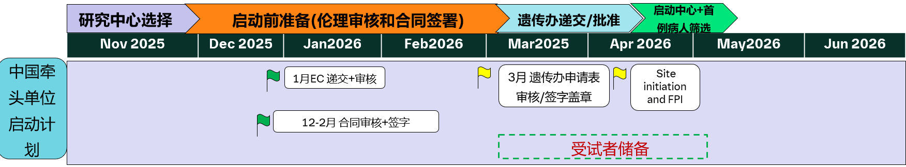
cGASi in SLE Ph2 (1509-0004) Global and China Timeline
381 days
293 days
64 days
64 days
2025
2028
2025 |  |  |  | 2026 |  |  |  | 2027 |  |  |  | 2028 |  |  |  | 2029
Q1 | Q2 | Q3 | Q4 | Q1 | Q2 | Q3 | Q4 | Q1 | Q2 | Q3 | Q4 | Q1 | Q2 | Q3 | Q4 | Q1 | Q2 | Q3 | Q4
ul
Dec
May
Oct
Mar
Aug
Jan
Today
1st SIV
LSS
Global
4/13/2026
6/25/2028
4/20/26 - 6/25/28
25 m N=405
Key Results
1/21/2029
5/27/2025 - 8/29/2025
pre-IND submission-approval
1/13/2026 – 2/13/2026
(30WD CTA Pathway）
CTA submission-approval
China
4/13/2026
1st SIV
4/20/2026
21 m, 11 sites, N=25
FSS-LSS
CTA获批后9周内启动项目（首例知情签署）
Global 1st SIV: China 1st site initiation on Apr 13th
Global 1st FSS: China 1st patient screen on Apr 20th, 3 weeks ahead of the commitment to HA (within 12 weeks to achieve FPI).
Investigator meeting planned on 16May in Xi’an.
Leading PI Prof. Li was invited to join global expert group. Global AB meetings planned in May and June.

Slide 39
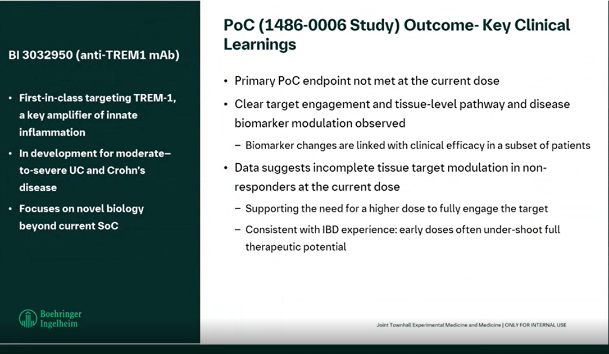

Slide 40
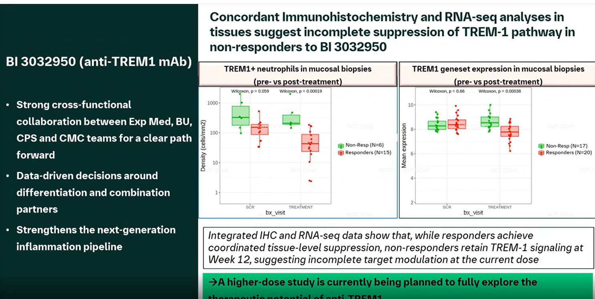

Slide 41
Ongoing:
BI 1819479 (Autotaxin inhibitor): IPF/ PPF
2024 |  | 2025 |  | 2026 |  |  |  | 2027 |  |  |  | 2028 |  |  |  | 2029 |  |  |  | 2030 |  |  |  | 2031
H1 | H2 | H1 | H2 | Q1 | Q2 | Q3 | Q4 | Q1 | Q2 | Q3 | Q4 | Q1 | Q2 | Q3 | Q4 | Q1 | Q2 | Q3 | Q4 | Q1 | Q2 | Q3 | Q4 | H1 | H2
We are here
Aug 2024
May 2025
Jan 2026
Ph2-
1462-0004
Ph2 IPF (N=300)
PoC in IPF
Mar 2026
EoPII Meeting
Feb 2027
RoFD
Sep 2027
FSS
LSR
LSC
Q4 2027
Q2 2030
Ph3 in IPF
Ph3
FSS
LSC
CMC packages backloaded after PoC
Ph3 in PPF
LSC
US sub
Q4 2030
US NDA
Q4 2031
FSS
Sep 2024
Jan 2025
Jan 2026
Ph2-
1462-0004
~3m
( N=24)
FSS
LSR
LSC
EoPII submission
Dec 2026
Ph3
Ph3 in IPF
Ph3 in PPF
CN NDA
Q4 2030
CN app
Q4 2031
FSS: First subject Screen
LSC: Last Subject complete
LSR: Last subject randomization
TLR in Mar indicated PoC was not achieved. PoC milestone moved from Mar IUEC to Apr IUEC.​

Slide 42

BI 3000202 (cGASi): Program Overview
Oct 1
Sep 1
Jun 17
Aug 23
Jun 13
Mar 30
Aug 20 - Mar 17
May 24 - Apr 26
Sep 11 - Dec 14
May 16 - Nov 7
Dec 15 - Apr 19
Feb 17 - Jan 11
1169.4 days
Jan 13 - Jun 27
1118.6 days
Jan 11 - Dec 4
410.6 days
1135.4 days
Mar 14 - Jun 27
Jan 9 - Jan 27
Oct 13
Aug 24
Oct 11
Mar 11
Aug 30
814.6 days
761 days
885.4 days
1394.6 days
1179 days
535 days
495 days
495 days
379.4 days
Oct 1
Jun 2
318 days
327 days
Jan 15
Apr 22
May 26
Mar 30
May 16
Aug 20
Sep 24
Sep 23
Jan 26
Aug 4
Apr 6
Sep 2
Oct 2
Oct 1
Today
2024
2026 | 2027 | 2028 | 2029 | 2030 | 2031 | 2032 | 2033 | 2034 | 2035 | 2036
Ph II(PoC study) SLE 32w+extension to 52w
PoC in SLE and SSC
Based on ph II 32w data
SLE
Ph III pivotal trial SLE 52 treatment
RoFD
Ph III pivotal trial SLE 52 treatment
US approval
Jun 10 - Jul 25
SSc
Ph III pivotal trial SSc 52 treatment
RoFD
US approval
Mar 11 - Aug 4
Jul 15 - Nov 22
Ph II-PoC study 24w
IFN
PoC in IFN
Sep 16 - Dec 4
RoFD
Ph III
US approval
Dec 12 - Jun 20

Slide 43
Overview of the Early Assets for China Integration
-Studies to initiate by 2028
2026 |  |  |  | 2027 |  |  |  | 2028
Jan | Apr | Jul | Oct | Jan | Apr | Jul | Oct | Jan | Apr | Jul | Oct
cGASi
Apr 2026
SLE- gPh2 (1509-0004)
To be updated
Nov 2027
UC- gPh2b (1486-0030)
Anti-TREM1
Nov 2027
CD- gPh2b (1486-0029)
IL-11
Jan 2028
IPF-gPh2b(1493-0010)
DcR3-Fc
Mar 2028
IBD- gPh2 (2007-0005))
Anti-CTGF
Nov 2026
IPF-gPh2a
IPF- gPh2b
Jan 2028
Trials with Integration to be further evaluated.

Slide 44
Back-up

Slide 45
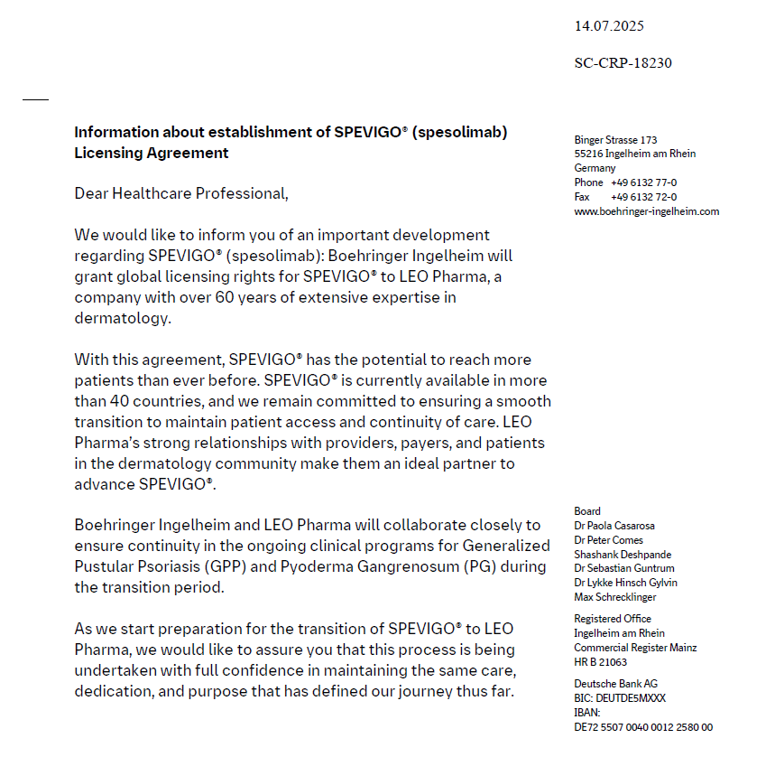
SPEVIGO® (Spesolimab): - License out
Boehringer Ingelheim will grant global licensing rights for SPEVIGO® to LEO Pharma on 1 Oct 2025.
Boehringer Ingelheim and LEO Pharma will collaborate closely to ensure continuity in the ongoing clinical programs for GPP and PG during the transition period.

Slide 46
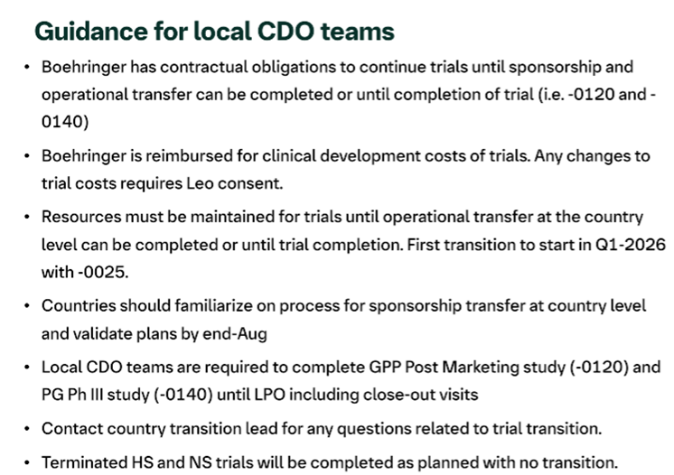

Slide 47
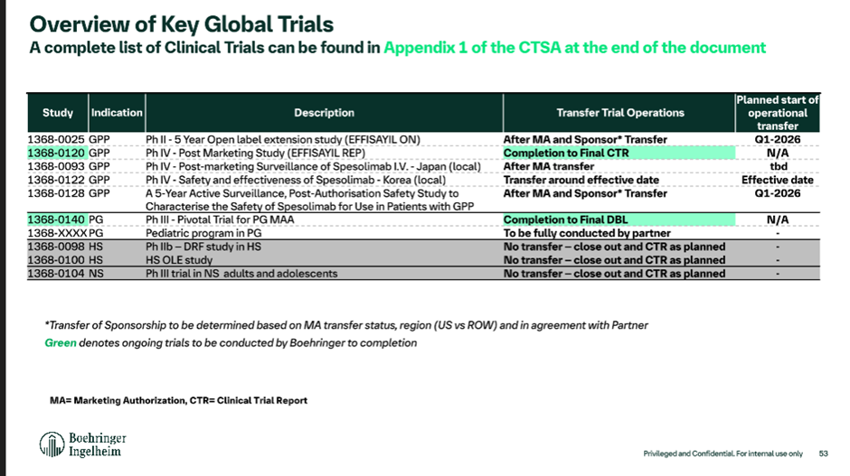

Slide 48
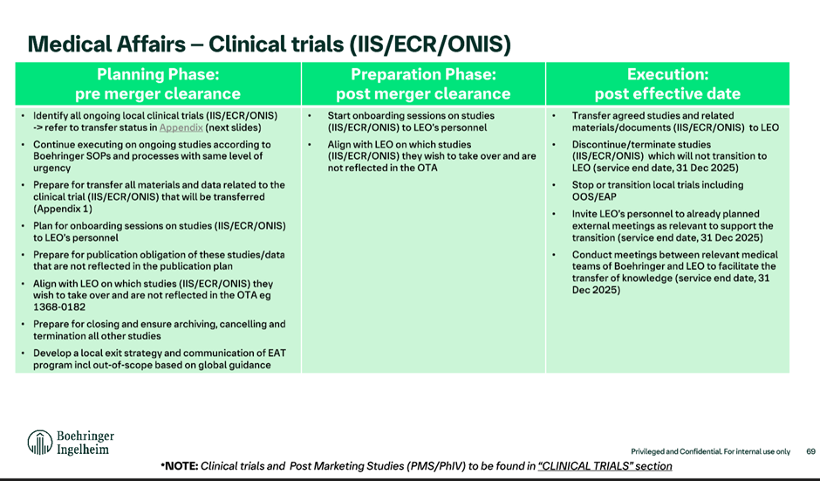

Slide 49
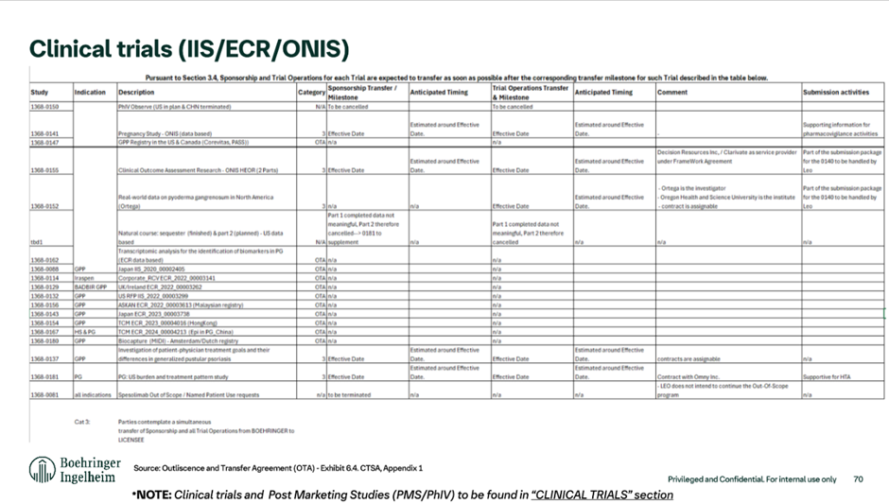

Slide 50
China is the current Top 1 recruiter (cut-off date: Sep 15, 2025)
19 Screened
6 In screening
9 Screen failed
4 Randomized

Slide 51
1397-0014 Amendment for the inclusion of adolescents LCI
LCI (lung clearance index): 11 countries have the capabilities to perform the LCI (25 sites)
LCI/MBW is a procedure which is difficult to standardize and interpret.
CORC centralizes and trains sites to conduct LCI in a standardized manner but also does a central readout.
  CORC is based in UK and was already validated and contracted for the Lenitvirus program
  CORC has partners in the US and Australia which might depending on capabilities perform these services in Australisia and the US, however, these partners are not validated by BI and would require separate contracts
  Team is currently collating all relevant information from the sites for the discussions with CORC and aims to have a contract only with this institute
  Evidence Team agreed to go with the sites first who can be covered by the CORC institute and if need be these will be the only ones; however, trial team to look into further solutions in parallel

Slide 52
1397-0018 trial (OLE) design (tbd Airtivity-on)
Long term safety and efficacy of BI 1291583 in patients with bronchiectasis
open label, uncontrolled trial for patients with bronchiectasis who completed AIRTIVITY or CLAIRLEAF
AIRTIVITY 2.5mg
R
Verducatib 2.5mg
AIRTIVITY placebo
Primary endpoint
Occurence of TEAs
Secondary endpoint
Annualized rate of PEx (no adjudication)
Change from baseline in FEV1 and FVC
Substudy
HRCT follow up for participants of the AIRTIVITY HRCT substudy 2 years after initial baseline CT in AIRTIVITY
Currently no further exploratoy efficacy endpoints planned
– tbc by Value
Site visit every 6 months
In between 1 phone visit
D1
w12
w26
w40
w52

Slide 53
Key assessments AIRTIVITY vs OLE trial comparison
Category | AIRTIVITY | OLE
Safety | Adverse events reporting incl. PEx review - PEx adjudication | Adverse events reporting incl. PEX review – no adjudication
 | Physcial exam, height, BW, Tanner stage | Physcial exam, height, BW, Tanner stage
 | Safety lab | Safety lab
PFT | PFT (LCI) | PFT (LCI)
PROs | PROs: BEST, Qol-B, CAAT, abbrev. SNOT-22, cough severity NRS (SGRQ at baseline) | x x
Biomarkers | Sputum: biomarkers, Murray sputum color chart, P.aeruginosa | x x
 | Blood biomarker samples | x
HRCT Sub study | Substudies: cough and sputum, HRCT | Substudies: follow up HRCT
PK | PK blood samples | x

Slide 54

NDA Submission Strategy Snapshot
2022 |  | 2023 |  |  |  | 2024 |  |  |  | 2025 |  |  |  | 2026 |  |  |  | 2027 |  |  |  | 2028 |  |  |  | 2029 |  |  | 2030
Q3 | Q4 | Q1 | Q2 | Q3 | Q4 | Q1 | Q2 | Q3 | Q4 | Q1 | Q2 | Q3 | Q4 | Q1 | Q2 | Q3 | Q4 | Q1 | Q2 | Q3 | Q4 | Q1 | Q2 | Q3 | Q4 | H1 |  | H2 | H1 | H2
Phase 3 1397-0014
Feb 2025
16 Jun 2025 FSS
Dec 2027
Aug 2028
AIRTIVITY 1397-0014 Phase 3
CTA
LPI (adults)
US NDA
US Approval
LPI (adols.)
LPI (adols.)
Sep 2024
Feb 2025
Jul 2025
Dec 2027
Best: Dec 2028
Base: June 2029
CTA Review + EC + HGRAC + 1st SIV (6m) *
AIRTIVITY 1397-0014 Phase 3
EoP2 HAI
Req. Subm.
CTA
1st SIV
LPI (adults)
CN NDA
China Approval
China Approval
LPI (adols.)
LPI (adols.)
DBL-1
Sep 2027
DBL-2
Mar/Apr 2028
Ready to recruit adult pts
NDA with Data from all adult pts & Data from partial of the planned adolescent pts
SNDA with data from all adolescent pts
CTP v1
1680 (only enroll adults)
1440 NCFBE
240 CFBE
CTP v1
Ready to recruit adol. pts
CTP v2
1680 adults
1440 NCFBE
240 CFBE
CTP v2
1755 (1680 adults + 75 adols)
Global challenge: to simultaneously complete adol. recruitment with adults recruitment
5 months recruitment window for adolescent pts. (critical path)
75 adolescents
≥70% NCFBE
≤30%CFBE

Slide 55
BI 1291583/verducatib (CatC/DPP-1 inhibitor): Bronchiectasis
2022 |  | 2023 |  |  |  | 2024 |  |  |  | 2025 |  |  |  | 2026 |  |  |  | 2027 |  |  |  | 2028 |  |  |  | 2029 |  | 2030
Q3 | Q4 | Q1 | Q2 | Q3 | Q4 | Q1 | Q2 | Q3 | Q4 | Q1 | Q2 | Q3 | Q4 | Q1 | Q2 | Q3 | Q4 | Q1 | Q2 | Q3 | Q4 | Q1 | Q2 | Q3 | Q4 | H1 | H2 | H1 | H2
Feb 2025
16 Jun 2025 FSS
19 Dec 2028, DBL
Mar 2029
Nov 2029
Phase 3
1397-0014
AIRTIVITY 1397-0014 Phase 3
CTA
US NDA
US Approval
Phase 3
1397-0018
1397-0018 Phase 3 nCFB+/- CFB roll-over study
Sep 2024
Feb 2025
Jul 2025
Phase 3
1397-0014
CTA Review + EC + HGRAC + 1st SIV (6m) *
AIRTIVITY 1397-0014 Phase 3
Best: Mar2030
Base: Sep2030
EoP2 HAI
Req. Subm.
CTA
1st SIV
Phase 3
1397-0018
Initial timeline
1397-0018 Phase 3 nCFB+/- CFB roll-over study
China Approval
16 Jun 2025 FSS
20 Sep 2027, DBL
Feb 2028
Oct 2028
Updated timeline
AIRTIVITY 1397-0014 Phase 3
US NDA Sub.
US Approval
Feb 2028
Feb 2029
CN NDA Approval | Best Case | Base Case
Initial timeline | Mar 2030 | Sep 2030
Updated timeline | Feb 2029 | Aug 2029
20 Sep 2027, DBL
AIRTIVITY 1397-0014 Phase 3
China NDA Sub.
CN Approval (best case)
DBL: - 14.7 months
Aug 2029
CN Approval (base case)
CN Approval: - 13 months
(best or base case)
we are here
Nov 17, 2025
Notes:
All adult subjects are expected to complete the trial by 2 August 2027.
All adolescent subjects are expected to complete the trial by April 2028.

Slide 56





Verducatib – Approval timeline in focus countries (adults + adols)
(not finalized for socialization)
 | 2027 |  |  |  | 2028 |  |  |  |  |  |  |  |  |  |  |  | 2029
 | 9 | 10 | 11 | 12 | 1 | 2 | 3 | 4 | 5 | 6 | 7 | 8 | 9 | 10 | 11 | 12 | 1 | 2 | 3 | 4 | 5 | 6 | 7 | 8 | 9 | 10 | 11 | 12
Milestone
Best Submission
Base Submission
DBL, 20 Sep 2027​
US/EU NDA Subm
US approval & launch (best)
US approval & launch (base)
JP NDA Subm
JP approval (best)
JP approval (base)
CN NDA Subm
CN approval & Lanuch (best)
CN approval & Launch (base)
US/EU NDA Subm
US approval & launch (best)
JP NDA Subm
JP approval (best)
JP approval (base)
CN NDA Subm
CN approval & Launch (best)
CN approval & Launch (base)

Slide 57
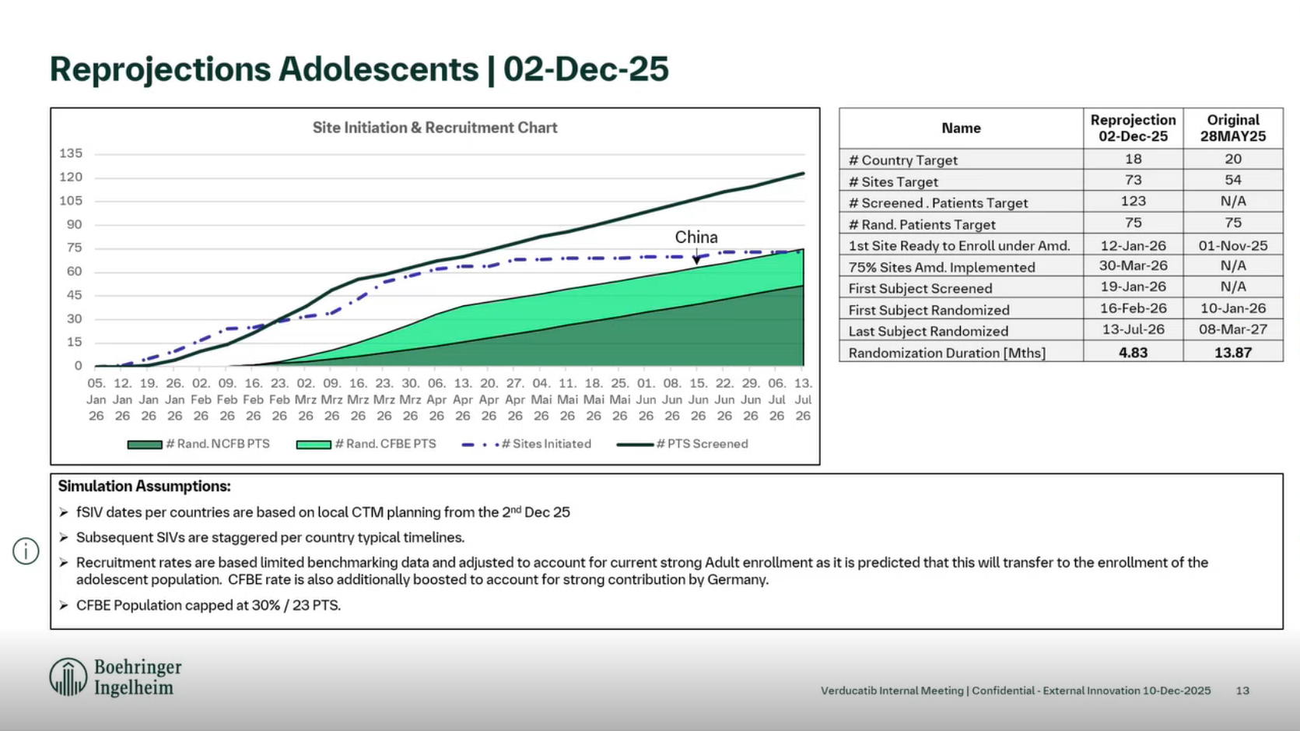

Slide 58
NDA scenario analysis
Scenarios | Pros | Cons | MItagation plan
Scenario #1 (Global Goal): Adolescent and adult recruitment completes simultaneously; and the labelled population includes 12 year and older patients with BE (no sNDA). | Simultaneous completion of recruitment, saving cost and budget; One DBL + One NDA + Broader Population (12y and older) (China) Priority review, NRDL premium pricing | NA | NA
Scenario #2: Adolescent recruitment completes much later than adult recruitment (DBL 1 for adults and DBL 2 for adols.); but the available adolescent data at DBL 1 is sufficient to support label inclusion of adols (no sNDA). | Same as above | Medium to high risk of sNDA, depending on the data totality; China HA may have objections as well | China contribution more adols. & CF patients. (see next slide)
Scenario #3: Adolescent recruitment completes much later than adult recruitment (DBL 1 for adults and DBL 2 for adols.); but the available adolescent data at DBL 1 is NOTsufficient to support label inclusion of adols (sNDA). | NA | (China)Chance for Priority review, NRDL premium pricing will be much lower

Slide 59
Next step actions – mitagation plan
To support global adolescent (and CF) recruitment
To be updated
#1: Submit for EC/GCP Approval at Existing Sites
Currently, two sites were seleced and added for adols recruitment More sites from the exisitng site list that are capable of adols recruitment could be considered.
#2: Engage The Two Adols. Sites for Recruitment
Proactively communicate start of adols. Recruitment per country (globa and local IMs, CTM/CRA/CRC site communication) Line up of adol. Patients Regular f/u with sites on progress/challenges of adol recruitment
Others

Slide 60







In-Class Competitor landscape in NCFBE/ ‘One’ BE
2024
2025
2026
2027
2028
2029
2030
2031
BI 1291583
Ph III: AIRTIVITY® (‘One’ BE)
Launch US CN
~4.5 years gap
~2 years gap
Brensocatib
Ph III data
Launch US, EU/JP in NCFBE
Ph III: China only
Similar time of entry
HSK31858
Ph II data
Launch CN
15 sites in overlap
Licensed out
Nov 20, 2023
Ph IIb/ III: outside China – tbd*
Launch US, EU/JP
Ph II China
Ph III China - timeline tbd
~1 year later？(TBD)
XH-S004
15 sites in overlap
LPLV 2027-04-28
Launch CN (tbd)
Licensed out
Aug 11, 2025
Ph II outside China – tbd*
Ph III outside China – tbd*
Ph II China
Ph III China - timeline tbd*
~2 year later？(TBD)
RSS0343
12 sites in overlap
Launch CN (tbd)
LPLV 2027-12
We are here
* Little knowledge about this program currently
Notes:
EU Feb
JP Apr
CN (end of) Jun

Slide 61


Competitor landscape beyond DPP1 inhibitors in NCFBE/ ‘One’ BE
2024
2025
2026
2027
2028
2029
2030
2031
BI 1291583
Ph III: AIRTIVITY® (‘One’ BE)
Launch US, EU, JP, CN
GSK3862995B
(aIL-33 mAb)
China Joining Global Ph II (NCFBE, n=363)
China Joining Global Ph III (tbd*)
7 sites in overlap
Launch CN (tbd*)
LPLV 2027-12
Similar time of entry
China Joining Global Ph II (NCFBE, n=312) (Enrolment completed)
China Joining Global Ph III (tbd*)
China Joining Global Ph II (NCFBE, n=363)
Itepekimab
(aIL-33 mAb)
Launch CN (tbd*)
8 sites in overlap
LPLV 2026-02-02
* Little knowledge about this program currently
Local competitions for trial enrolment：
Two ph2 and 1 ph3 trials for other DPP1 inhibitors are ongoing
  10-15 overlapping sites with each competitor
Two aIL-33 mAb ph2 trials are ongoing
  7-8 overlapping sites with each competitor
Notes:
EU Feb
JP Apr
CN (end of) Jun

Slide 62
Overview of In-Class DPP1/CatC Inhibitor Competition
 | BI 1291583 phase 2 data | HSK31858 (Florensocatib) phase 2 data
MoA | DPP1/CatC inhibitor
Formulation & RoA | Once daily oral tablet (2.5mg) | Once daily two oral tablets (2x20mg)
Description of MoA / pharma-cological effect | Reduces NSPs and with that neutrophilic inflammation in the lung
Population | BE ≥ 2 PEx in past year or 1 PEx + high symptom score | NCFBE (primary diagnosis of COPD/asthma was excluded) ≥ 2 PEx in past year (Haisco)
EP - reduction in PEx | Key 2° EP: 32.3% (47% for Asian sub-group, n=14) at 2.5mg | 1° EP: 46.8% (20 mg, n=74) and 60.1% (40mg, n=75)
EP - time to first pulmonary exacerbation | 1° EP: 34% risk reduction in events at 2.5 mg (n=53) (HR=0.66) (59% for Asian sub-group, n=14) | 2° EP: 57% and 67% reduction in events at 20 mg (n=74) and 40 (n=75) mg (HR=0.43 and 0.33)
 | Note: Non-head-to-head comparison & baseline demographics differ between BI and HSK HSK31858 data were only generated in Chinese population BI 129583 data in Asian sub-group was comparable with HSK31858
Coming ~4.5 years (globally) and ~2 year (China) later, having strong and differentiating* data at launch is key.
Several areas for differentiation are being explored and focused investment into evidence generation beyond Ph III is proposed to react flexibly to competitive positioning and market development
*Statements regarding differentiation or comparison to competitors are aspirational only; no superiority or comparative claims will be made upon approval due to lack of head-to-head data. All claims must be approved by HPRC.
62

Slide 63
Local strategy to move forward… (draft)
Based on the expedited global recruitment timeline & increasing competition from external pipelines in China
Activities | Purpose | Lead Role
Cross-trial comparison: Key Eligibility Criteria Dive-in Key Study Process Dosing form (oral vs IV/SC) Prior efficacy & safety data MoA advantage Trial stage (ph2 vs ph3) | Identify differentiating advantages & benefits for patients | Medical/Clinical
Site/PI Engagement: Boost visit? City Meetings? Ab meeting | Engage trial participating PIs Leverage the connection of the PI with experts not participating AIRTIVITY trials for referral | CD&O
External Promotion: WeiXin/WeChat official platform National/Regional Congress/Conference | Increase exposure to external targeted experts/patients | MA

Slide 64
BI 3000202 (cGAS inhi) in SLE (1509-0004, ph2)
Timeline / Current status_7Jan2026
Milestones | Global |  | China
 | Planned date | Actual date | 30 CTA accelerate process | Original planned date | Actual date
TDO Final | 06-Oct-25 | 06-Oct-25 | / | / | /
Final Protocol | 17-Nov-25 | 18-Nov-25 | 17-Nov-25 | 17-Nov-25 | 18-Nov-25
First EC submission | 22-Dec-25 | 17-Dec-25 | 5-Jan-26 | 12-Jan-26 | 30-Dec-25
CTA submission | 22-Dec-25 | 17-Dec-25 | 19-Jan-26 | 22-Dec-25
First EC approval | 04-Feb-26 |  | 6-Feb-26 | 28-Feb-26
CTA approval | 11-Feb-26 |  | 6-Mar-26 | 31-Mar-26
HGRAC submission | / | / | 16-Mar-26 | 15-Apr-26
HGRAC approval | / | / | 23-Apr-26 | 25-May-26
First SIV | 06-Apr-26 |  | 30-Apr-26 | 30-May-26
First Subject Screened | 07-Apr-26 |  | 15-May-26 | 15-Jun-26
First Subject Randomized | 12-May-26 |  | 15-Jun-26 | 15-Jul-26
Last Subject Randomized | 25-Jun-28 |  | 25-Jun-28 | 25-Jun-28
DBL | 15-Jul-29 |  | 15-Jul-29 | 15-Jul-29

Slide 65
Interaction to align with CDE on China participating in the Global Phase II trial of BI 3000202 in SLE – submitted on 27 May 2025
Feedback from CDE regarding China integration in global phase II study - 1509.0004
Clinical division | Clin-pharm division
July 25th 2025 Based on the briefing document, China join the global phase II MRCT is reasonable. | Aug 20th 2025 Agree with China join the global Phase II clinical trial.
When submit the CTA, please provide the rationale that no safety risk to increase exposure in Asian SLE patients. The final review decision shall prevail. | It is recommended that in the global Phase II clinical trial, enroll Chinese patients in low-dose (25mgBID) arm firstly and compare the PK, PD and safety data obtained from these Chinese patients with the entire population. If the above characteristics are basically consistent, then enroll Chinese patients in higher dose arms.
→ Justify in the CTA that increased exposure poses no safety risk for Asian SLE patients. | Strategy to push back CDE‘s recommendation (submitted on 27 Aug） Alignment meeting on 26 Aug – global & local teams
N.A | CDE accepted with further comment on 29 Aug: Suggest to comprehensively consider the available data to ensure the safety of the subjects. When submit the CTA, please provide the detailed rationale that no safety risk to increase exposure in Asian SLE patients.
 | → Justify in the CTA that increased exposure poses no safety risk for Asian SLE patients.

Slide 66
Leading PI endorsed by ad hoc PEC (9th Oct)
Potential investigator name** | Hospital/ department** | Academic experience, especially in clinical studies (weight 15%**) | Impact in Therapeutic Area (weight 20%**) | Leading PI feasibility (weight 30%**) | Leading site start up timeline feasibility (weight 35%**) | Total Grade | Finial proposal for leading PI selection (Y/N)
李梦涛 | 北京协和医院 | Prof Li focus on the treatment of SLE, sjogren syndrome, rheumatoid arthritis, spondyloarthritis, systemic vasculitis, scleroderma, dermatomyositis, connective tissue disease-related pulmonary hypertension and other rheumatoid immunopathy. 1. Clinical trial experience: China Leading PI and global SC member in 1305-0046 ph3b trial (SARD-ILD); China leading PI in Belimumab ph3 in CTD-ILD (GSK), and PIT565 ph1 (Novartis). Lead 3 China single center clinical studies​. Several sub-I experiences in global/local RCT (leading PI 曾小峰） ​ 2. <Recommendations for diagnosis and treatment of systemic lupus erythematosus 2025> author 3. Published 138 Sci-cited papers related to SLE Grade: 9/10 (13.5) | 第十二届中华医学会风湿病学分会委员会主任委员；北京医学会风湿病学分会主任委员；中国医师协会风湿免疫科医师分会副会长兼肺血管/间质病学组组长；亚太抗风湿病联盟（APLAR）系统性红斑狼疮研究组成员；亚太系统性红斑狼疮协作组（APLC）成员；中国系统性红斑狼疮研究协作组（CSTAR）、国家风湿病数据中心（CRDC）、中国风湿免疫病医联体联盟（CRCA）秘书长，国家皮肤与免疫疾病临床医学研究中心（NCRC-DID）办公室主任 Grade: 10/10 (20) | Leading PI of 1305-0046 (SARD-ILD,ph3) CTID: 5 leading I-III studies (2 SLE ph1 studies, collaborate with MNCs like Novartis and GSK, and other local biotechs.) The experience of leading PI is limited, especially for MRCT. Grade：6/10 (18) | Trial Set up: 2 weeks EC approval: 1-1.5 months HGRAC: 2 weeks to get signature Contract negotiation: MSA (renew is under negociation), 2 months to finalize (risk: publication and IP sharing) EC submission ahead of CTA approval; bi-weekly EC meeting; EC/CTA in parallel review Summary: 4-6 months for initiation meets the 6 months benchmark of BI ; Lading site for 1305-0014 & 1305-0023 & 1305-0031 (ILD, ph3)/1305-0046 (SARD-ILD, ph3)/1366-0031(SSc, ph2) study Risk: Potential publication per PI’s request and IP sharing. Grade: 9/10 (31.5%) | 81.25% | Y 1509-0004

Slide 67
BI 3000202 (cGASi) in SLE (slide under preparation)
2025 |  | 2026 |  |  |  | 2027 |  |  |  | 2028 |  |  |  | 2029 |  |  |  | 2030 |  |  |  | 2031 |  |  |  | 2032 |  | 2033 |  | 2034
Q3 | Q4 | Q1 | Q2 | Q3 | Q4 | Q1 | Q2 | Q3 | Q4 | Q1 | Q2 | Q3 | Q4 | Q1 | Q2 | Q3 | Q4 | Q1 | Q2 | Q3 | Q4 | Q1 | Q2 | Q3 | Q4 | H1 | H2 | H1 | H2 | H1 | H2
Aug 2029
Dec 2024
Phase 2
1509-0004
Ph II 1509-0004
Apr 2026
Key results
RoFD
May 2029
PoC
Phase 3
1397-0014
Feb 2025
16 Jun 2025 FSS
Phase 3
CTA
Phase 3
Phase 3
1397-0018
Sep 2024
Feb 2025
Jul 2025
20 Sep 2027, DBL1 (adults)
Phase 3
1397-0014
CTA Review + EC + HGRAC + 1st SIV (6m) *
AIRTIVITY 1397-0014 Phase 3
Jan 31, 2028, DBL-2 (adolescents)
EoP2 HAI
Req. Subm.
CTA
1st SIV
Phase 3
1397-0018
1397-0018 Phase 3 nCFB+/- CFB roll-over study
1680 adults
1440 NCFBE
240 CFBE
Dec 2027
Best: Dec 2028
Base: June 2029
Phase 1 PK
1397-0027
13 Jul 2026
11 Oct 2026
Apr 2027
CTP v2
1755 (1680 adults + 75 adols)
Protocol develop
CTA Review + EC + HGRAC + 1st SIV (6m) *
China PK
FSS
LSO
Key PK results
CN NDA
China Approval
China Approval
75 adolescents
≥70% NCFBE
≤30%CFBE
CTP v3 – Mid Apr 2026
DBL Timing - Flexibility
we are here

